Slide 1

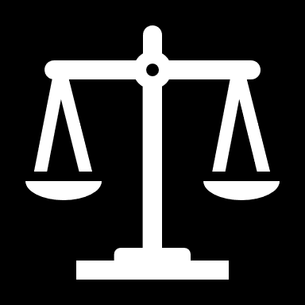
How The Balance
Is Tipped?
Predict The Months of Imprisonment sentenced on Drunken Driving Through Mining from Written Verdicts
盧奕盛，林成鍇 @ 108 Statistical Machine Learning & Applications
Advisor: Prof. Po-Hsien Huang

Slide 2
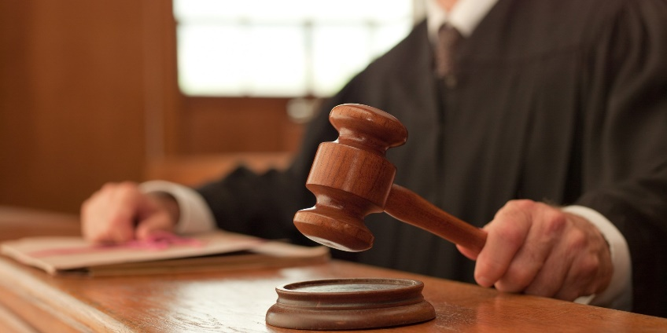
To capture or describe (more or less) the “Golden Rule” of how a judgement against drunken driving is made.
What are the factors which play roles in directing the judgement?
To what extent?
Motive

Slide 3
Outline
Text Mining
Exploratory Data Analysis & Visualization
Model Fitting & Interpretation
Modelling Approach for Practical Application
Further Discussion

Slide 4

Text Mining
Source
Process of Text Mining

Slide 5
Open Source Data
109年的裁判書( opendata http://data.judicial.gov.tw/ )
109年的終結案件(政府資料開放平台搜尋終結案件)
篩選出公共危險罪中酒駕刑事案件的判決書(約28000件)
排除撤銷、駁回、不受理、免除其刑之案件
排除多位被告33件
排除沒有終結案件的判決書1229件

Slide 6
Features Extracted (In Progress)
法官
最終判刑月數
法條
地區
酒精濃度
交通工具
犯罪次數
……

Slide 7
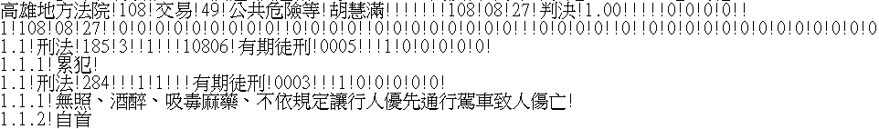
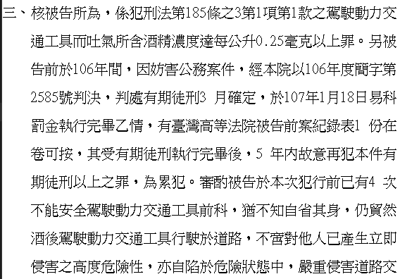
是否累犯
累犯次數

Slide 8
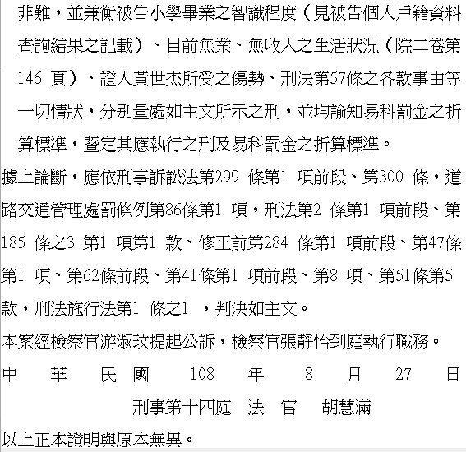
法條
Step1:存出法條段落
方法if len( txt.split(目標字串) ) ==2:
逕以簡易判決處刑如主文
刑法施行法第
判決處如主文
判決如主文
處刑如主文
判決判處如主文
適用之法條
適用之法律
依刑事判決精簡

Slide 9
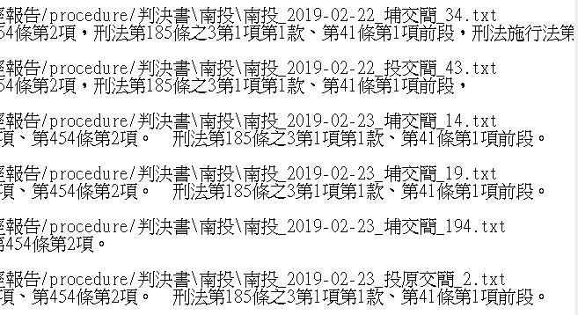
法條
Step2:切割並存出犯特定哪幾條
1.得到出現過法規名稱的:
2. replace(法規名稱, “&”+法規名稱)
再split(“&”)後可確定裡面每個元素皆屬同個法規。

Slide 10
Exploratory Data Analysis
Missing Data Handling
Data Visualization
Model Fitting & Results Presentation
LASSO Regression
Random Forest Regression
Neural Network (Regression)

Slide 11
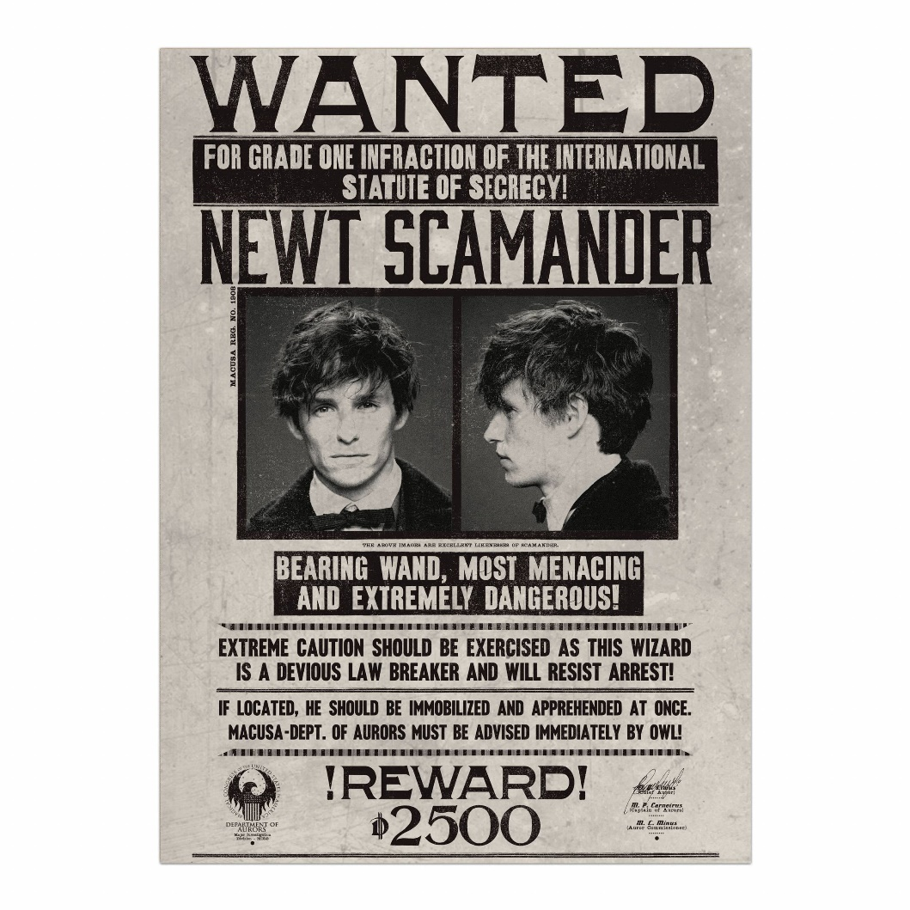
Missing Data Handling
‘是否累犯’
SUM(NaN) = 0
‘累犯次數’
SUM(NaN) ≈ 8000
How they are to be combined to a single column (犯罪次數) yet still preserving all the info. given?

Slide 12
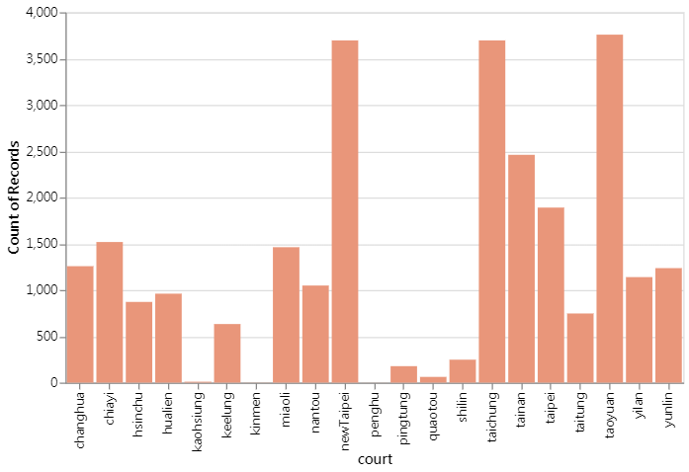
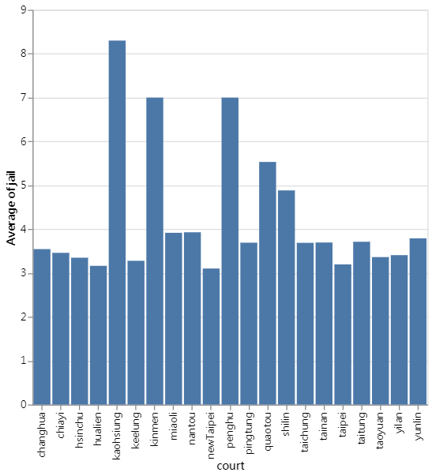
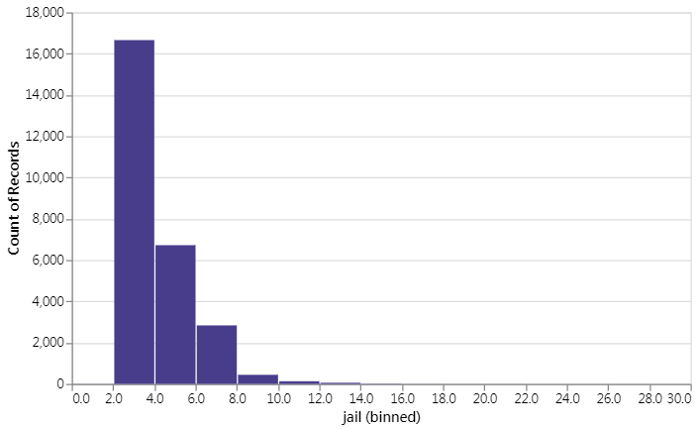

Slide 13
index | correlation | correlation_label
0 | changhua | 0.005639 | 0.01
1 | chiayi | -0.006102 | -0.01
2 | hsinchu | -0.016601 | -0.02
3 | hualien | -0.038601 | -0.04
4 | kaohsiung | 0.054868 | 0.05
5 | keelung | -0.020577 | -0.02
6 | kinmen | 0.017887 | 0.02
7 | miaoli | 0.059019 | 0.06
8 | nantou | 0.050994 | 0.05
9 | newTaipei | -0.094585 | -0.09
10 | penghu | 0.012648 | 0.01
11 | pingtung | 0.009167 | 0.01
12 | quaotou | 0.057874 | 0.06
13 | shilin | 0.079018 | 0.08
14 | taichung | 0.044026 | 0.04
15 | tainan | 0.036442 | 0.04
16 | taipei | -0.049794 | -0.05
17 | taitung | 0.021105 | 0.02
18 | taoyuan | -0.033153 | -0.03
19 | yilan | -0.011796 | -0.01
20 | yunlin | 0.037523 | 0.04
The correlation between “court” and “jail” are barely negligible.

Slide 14
Correlation “alcohol” & “jail” = 0.20
Correlation “total_crime_nums” & “jail” = 0.59

Slide 15
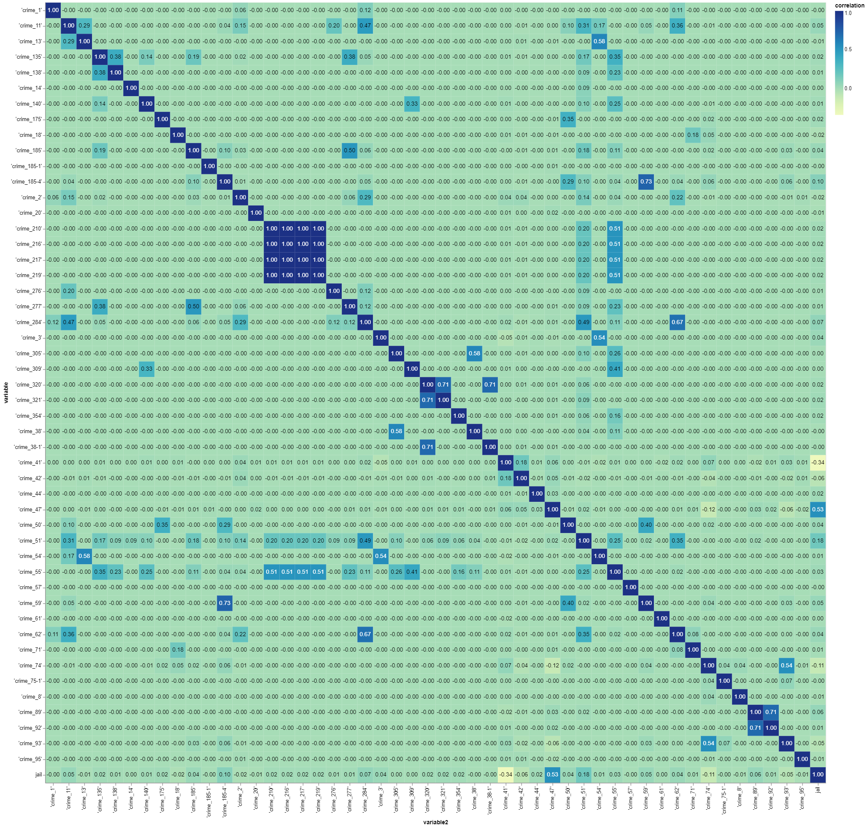
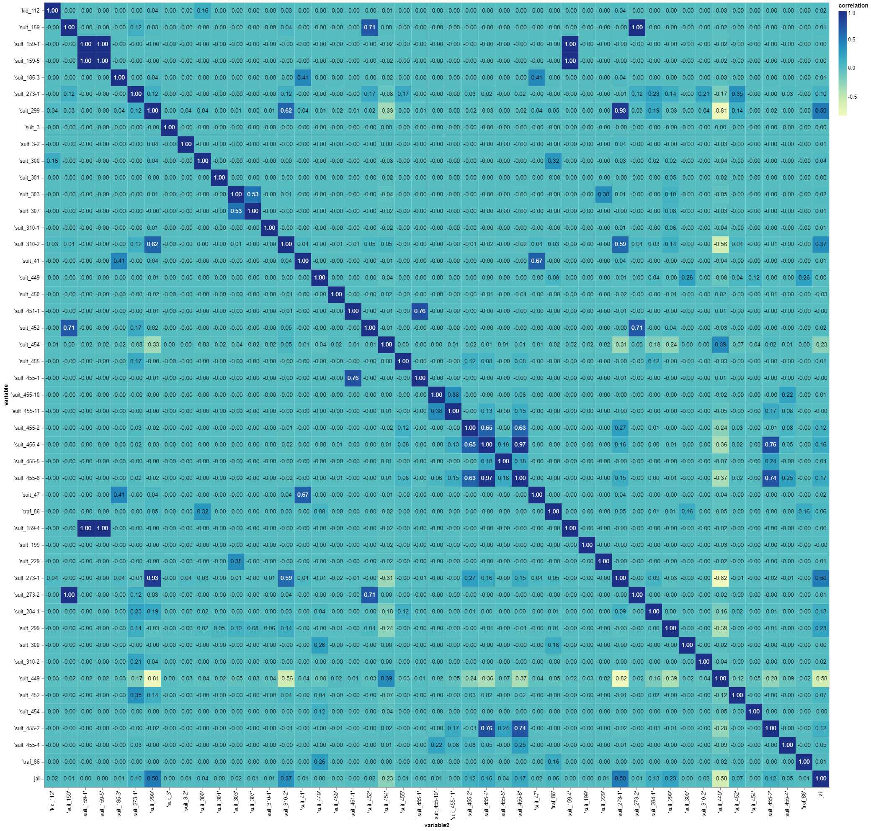
Series of Correlation Heatmap (Act .corrwith “jail”)

Slide 16
Features
法官
最終判刑月數（Y）
法條
地區
酒精濃度
交通工具
犯罪次數

Slide 17

Model Fitting & Results Presentation
LASSO Regression
MSE = 1.15, R-square = 0.60
Random Forest Regression
MSE = 1.03, R-square = 0.64
*** Decision Tree Regression
MSE = 1.06, R-square = 0.63
Neural Network (Regression)
MSE = 1.02

Slide 18
Modelling Approach for Practical Application
Phased Prediction
LASSO Regression with Currently Available Factors
Further Discussion
Quality of Data
Features-to-be-Mined from Text

Slide 19


Post hoc ergo propter hoc

Slide 20
Ex Ante Prediction
Ex Post Prediction
Facts
Facts
+
Laws & Acts
Punishment
Punishment
Laws & Acts

Slide 21
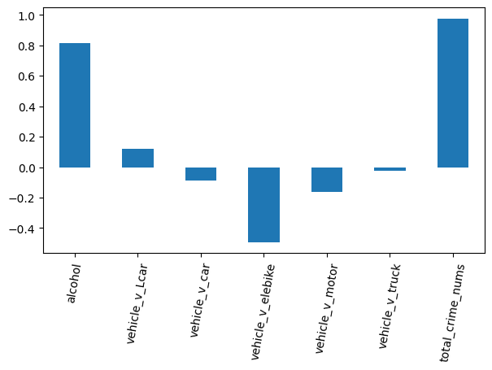
LASSO Regression with Currently Available Factors
MSE = 1.73
R-square = 0.40

Slide 22

Quality of Data
Sherlock-ing the verdicts for the features
Eg. Vehicles
Cue 1 = “駕駛” or “騎乘”
Cue 2 = “車牌號碼”
Cue 1 + Cue 2 = Strong Evidence
……
There’s probability of “Capturing the Wrong Suspects”.
Let alone the missing values in “犯罪次數”.

Slide 23
Features-to-be-Mined
Attitudes(拒酒測，配合度etc.)
Educational Background & Career
Family Background & Members
Socio-economic Status

Slide 24
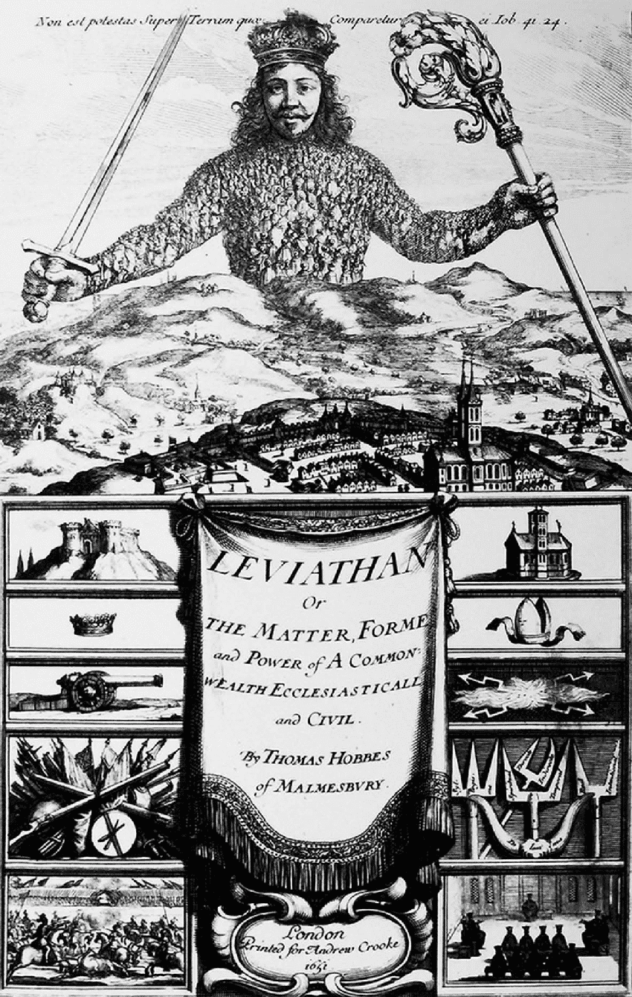
‘The law is the public conscience’
- Thomas Hobbes

Slide 25

Thank You
FOR WATCHING AND LISTENING

